Slide 1
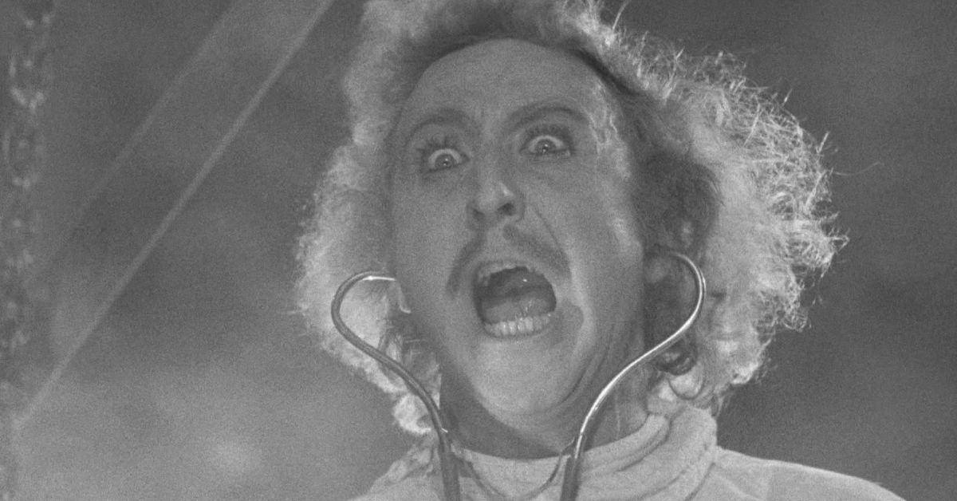
MAD SCIENTISTS!
Notes:
Dark topics ahead: brief mentions of suicide, war, the holocaust and nazis, weapons

Slide 2
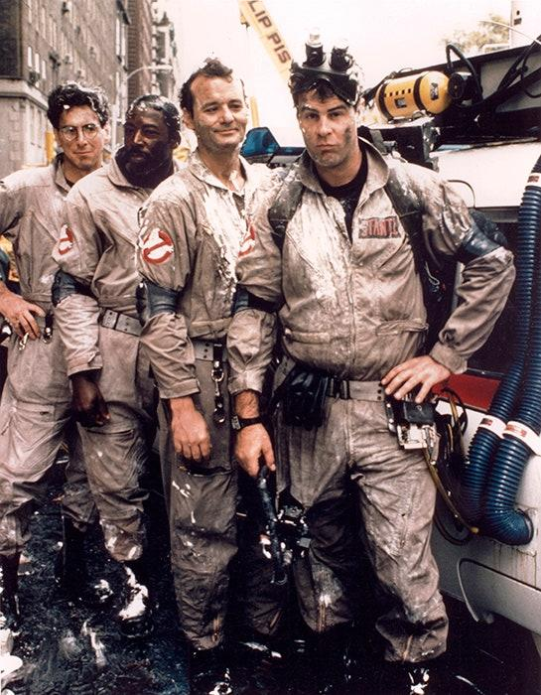
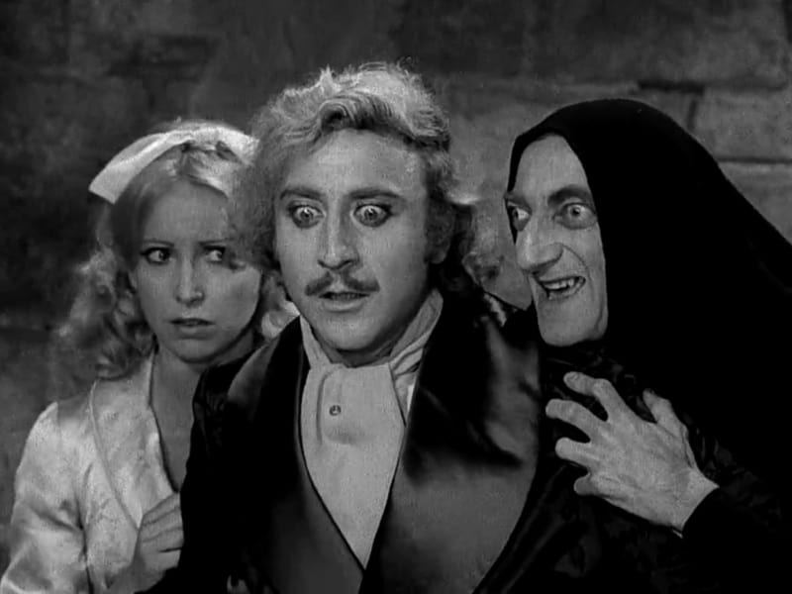
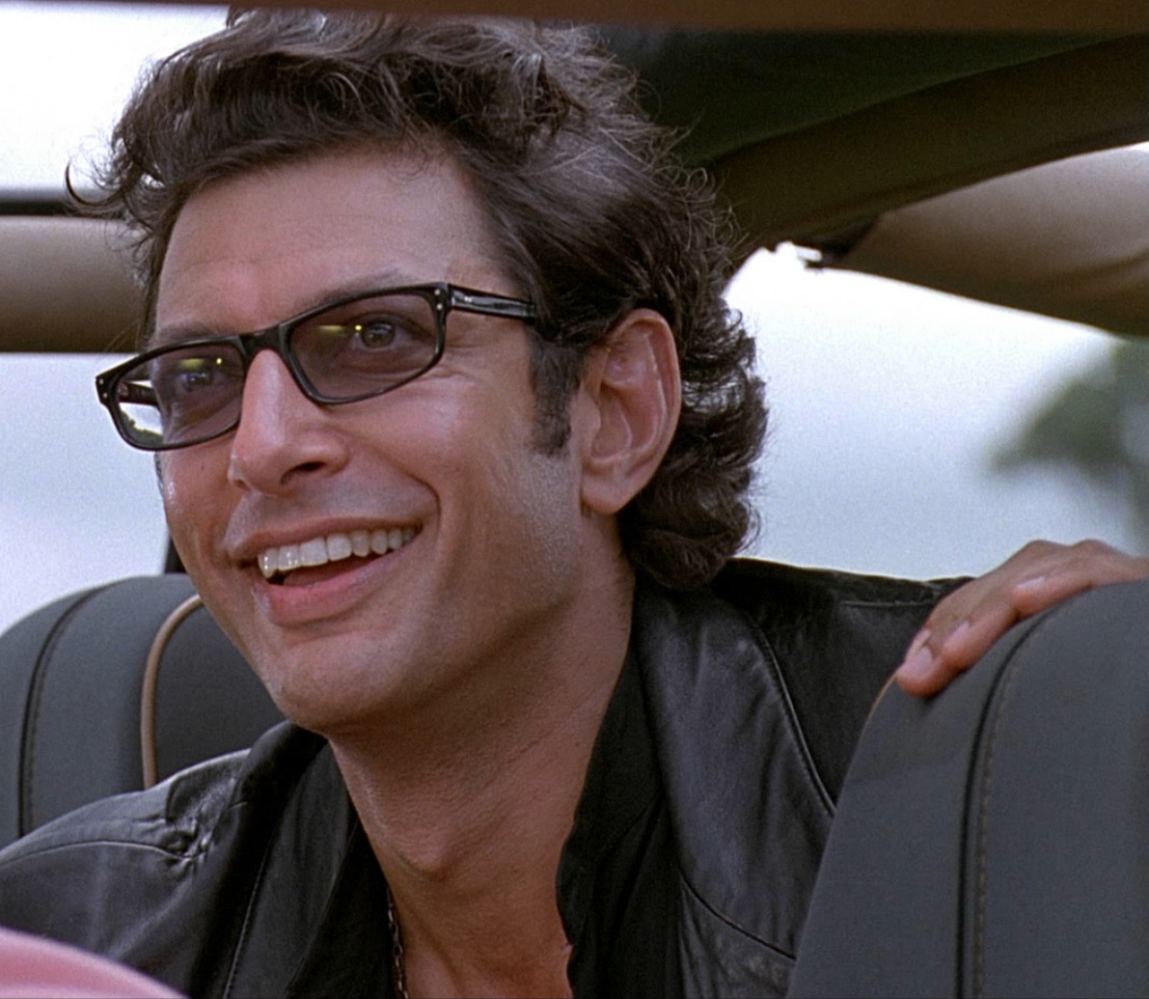
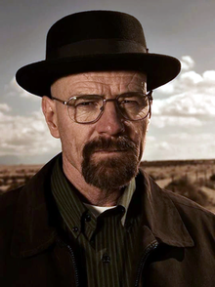
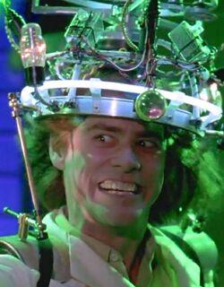
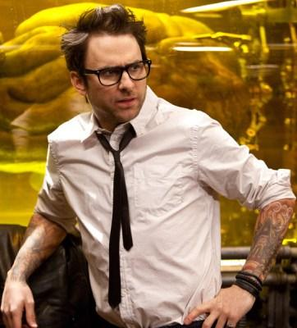
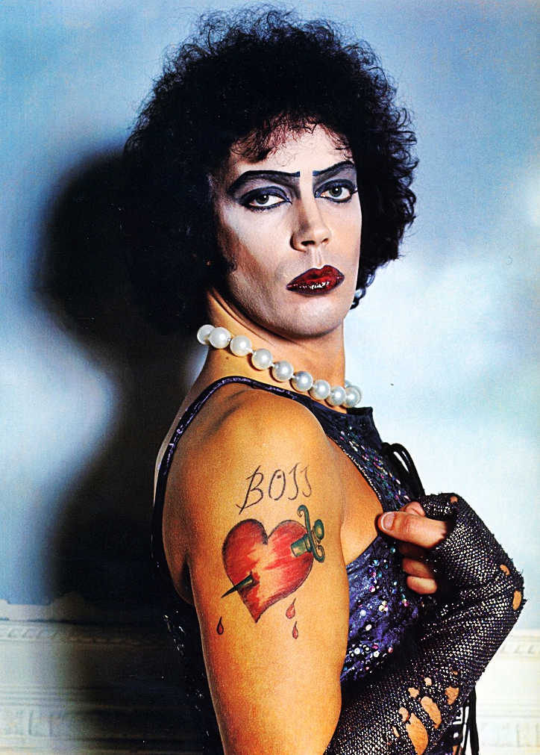
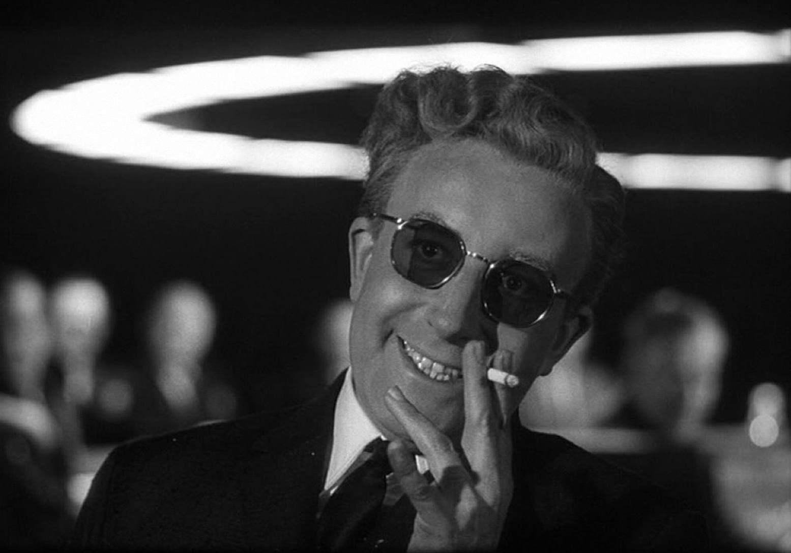
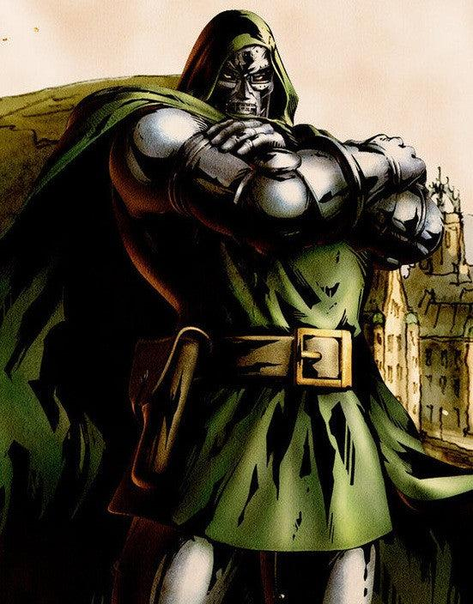
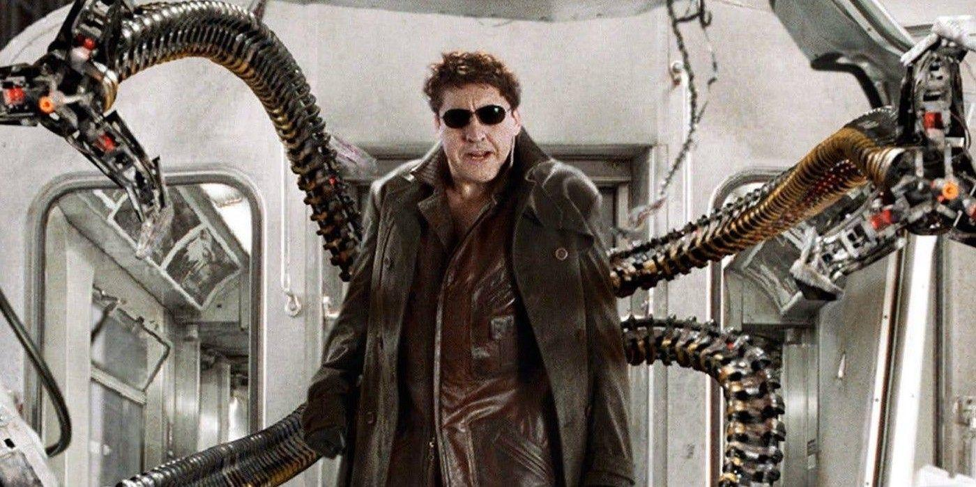

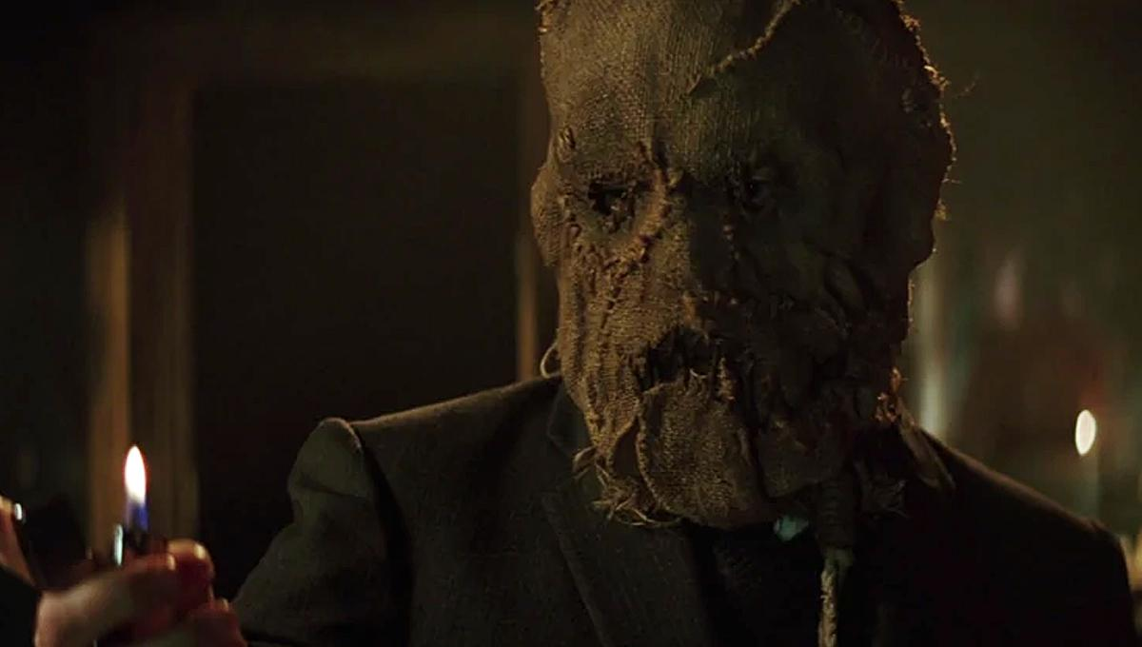
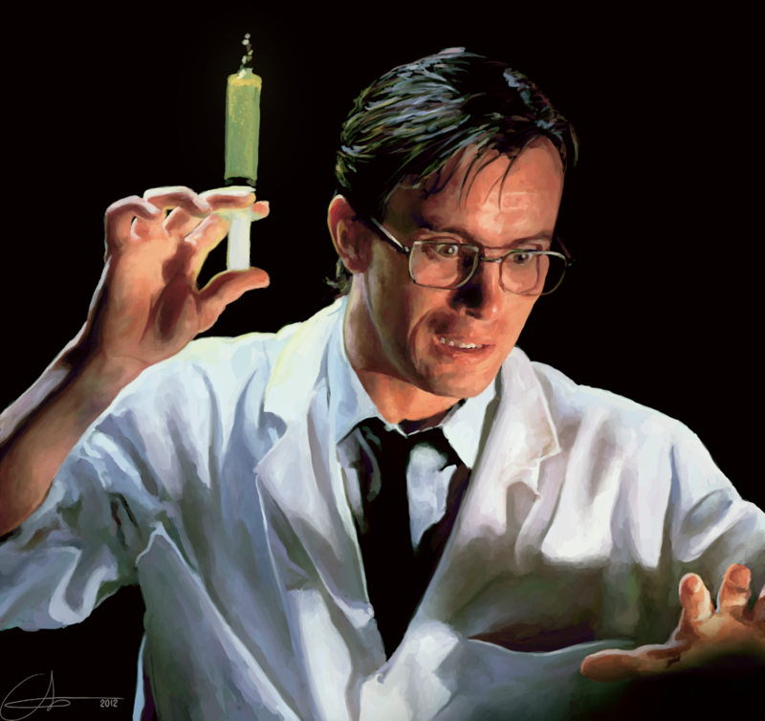
Notes:
In fiction: comes in many forms!
The brilliant villain who uses science for evil
Not necessarily evil but simply obsessive and eccentric
Respected scientist with a dark background
Many, esp modern examples, are inspired by real life figures
Thats where my project comes in

Slide 3
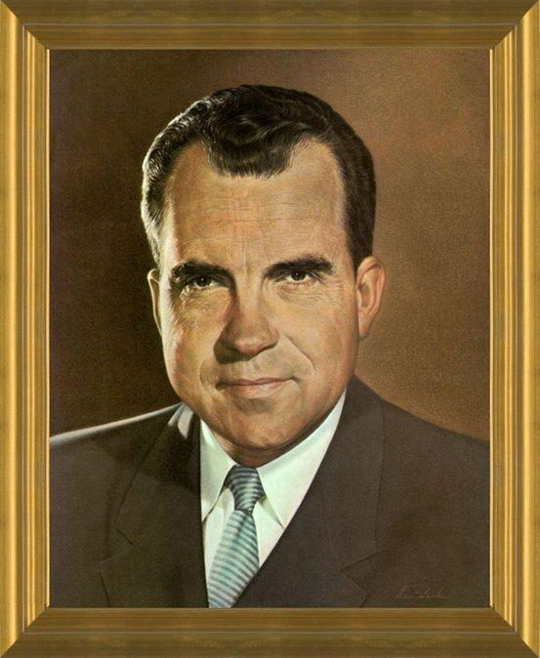
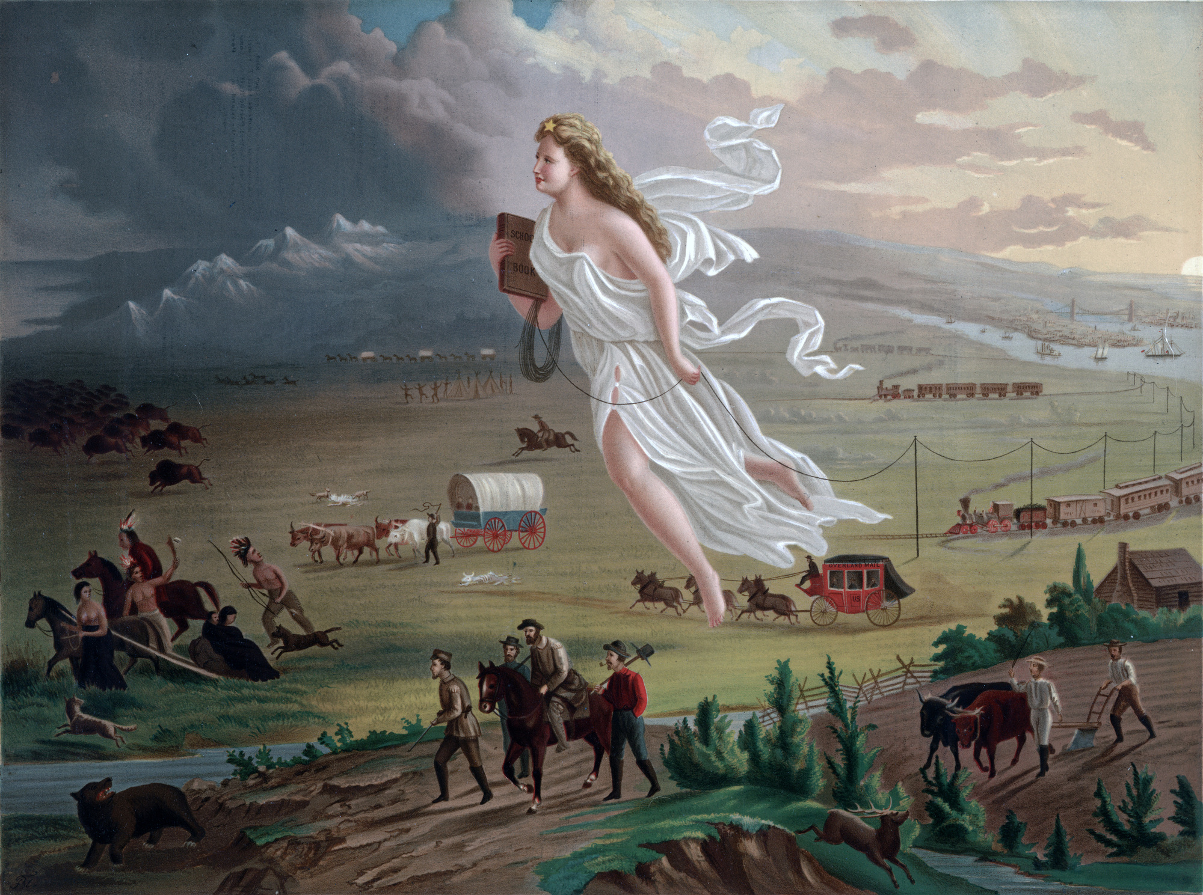
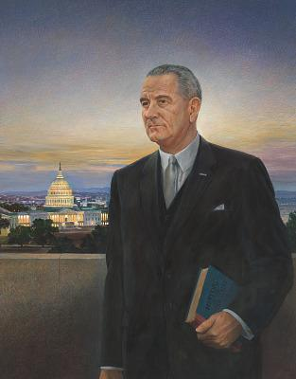
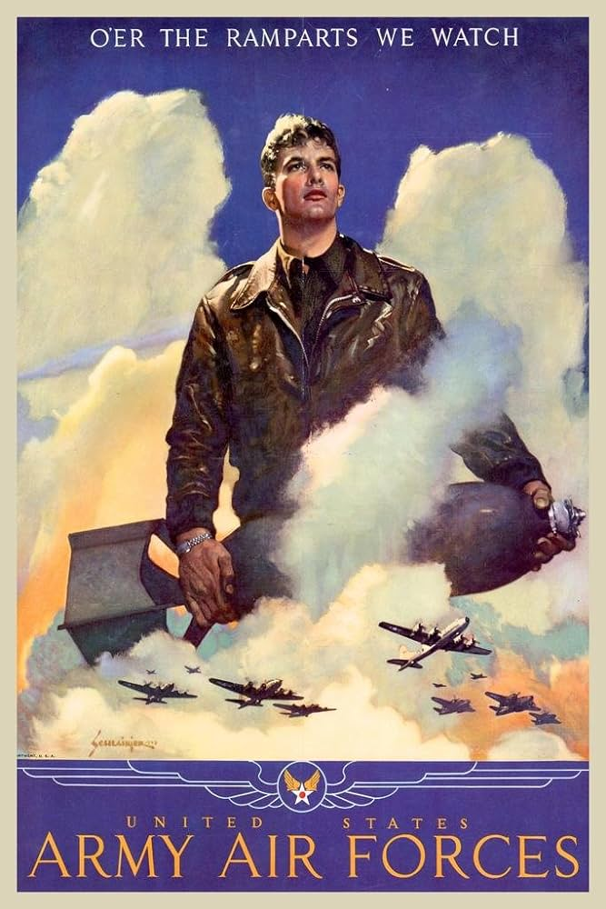
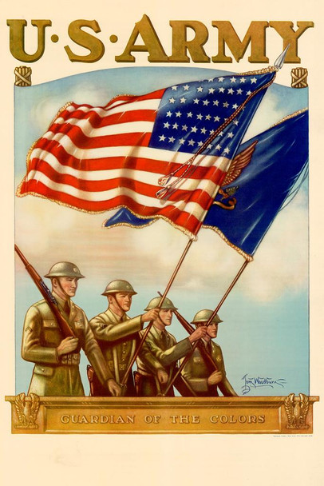
Inspiration!
Notes:
The concept: portraits of historical “mad scientists”, all whose reputations have been painted over by political and cultural acceptance
Glorified presidential portraits
Propaganda and advertising, political especially, focus on colorful and beautiful landscapes

Slide 4
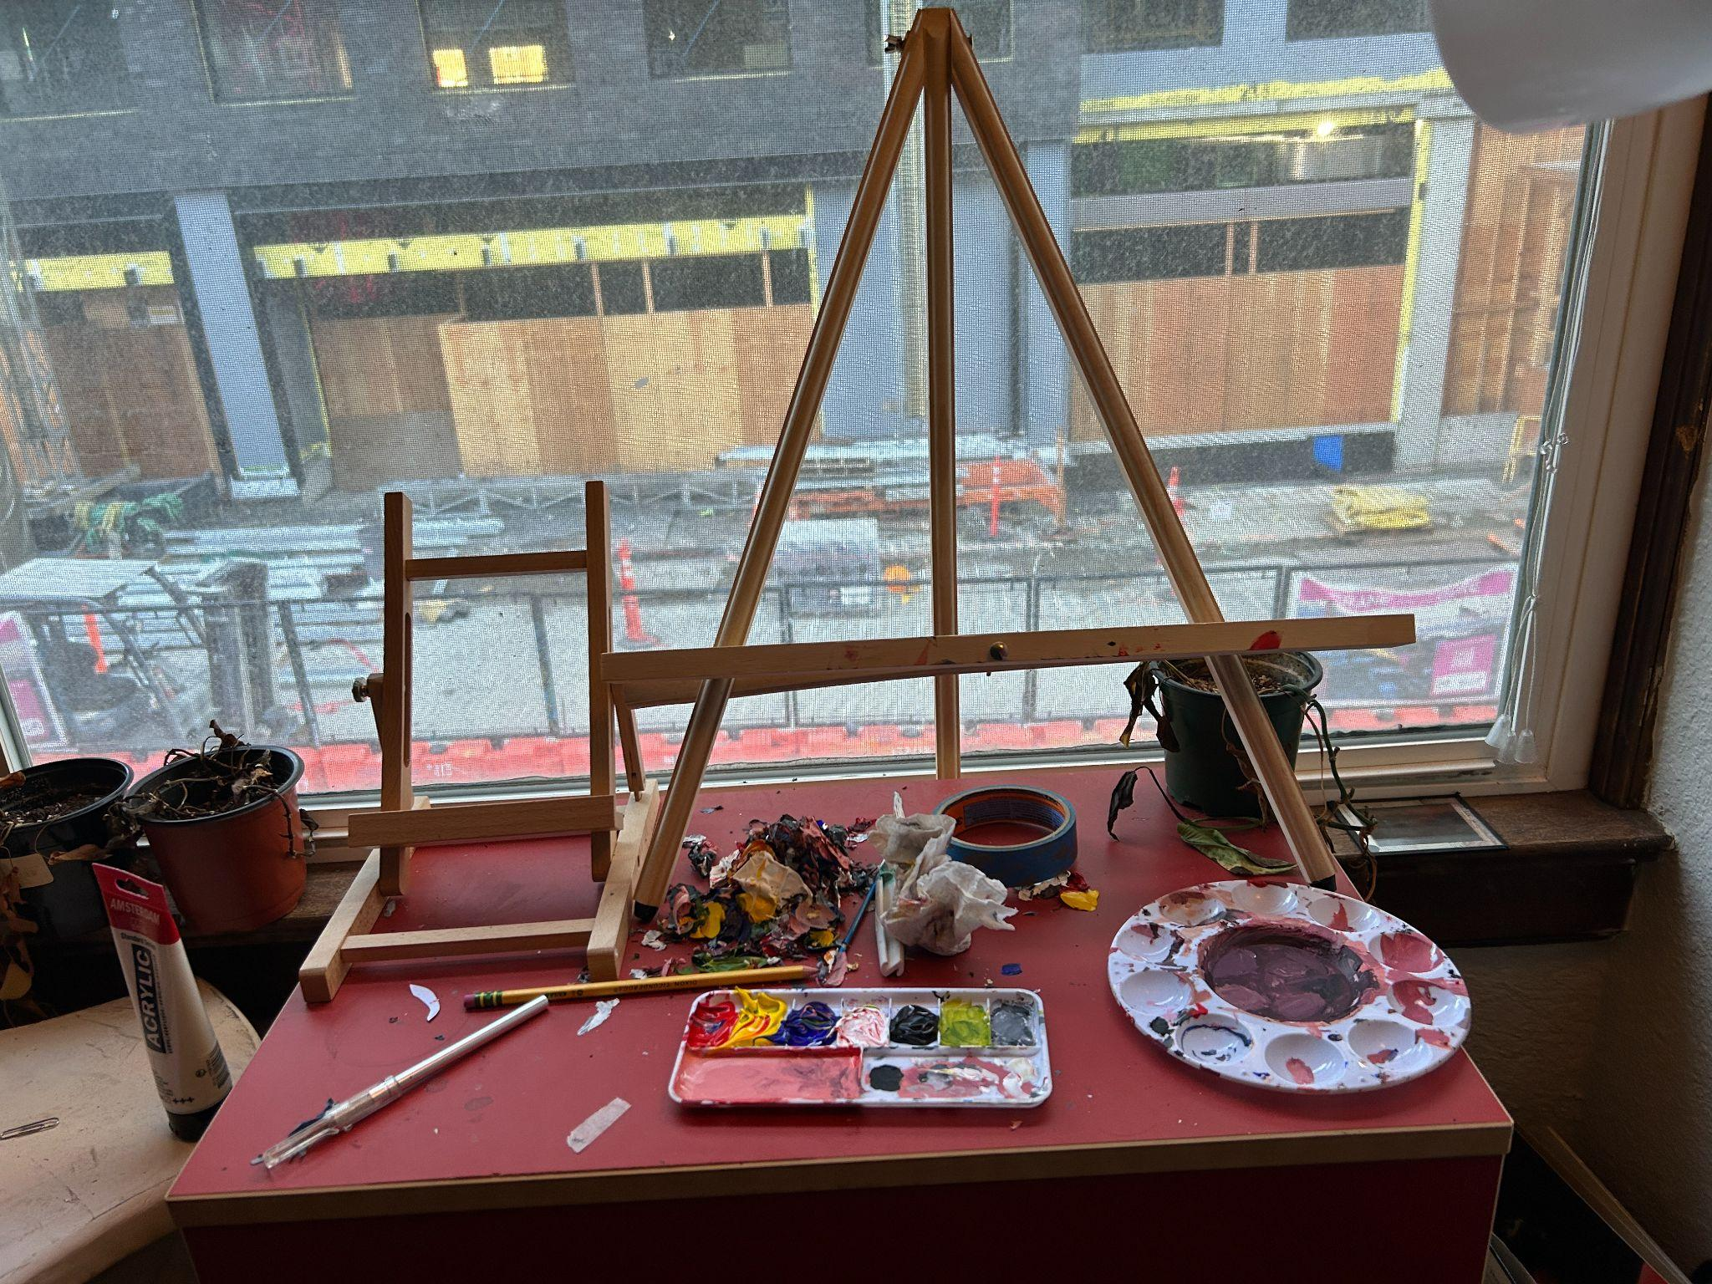
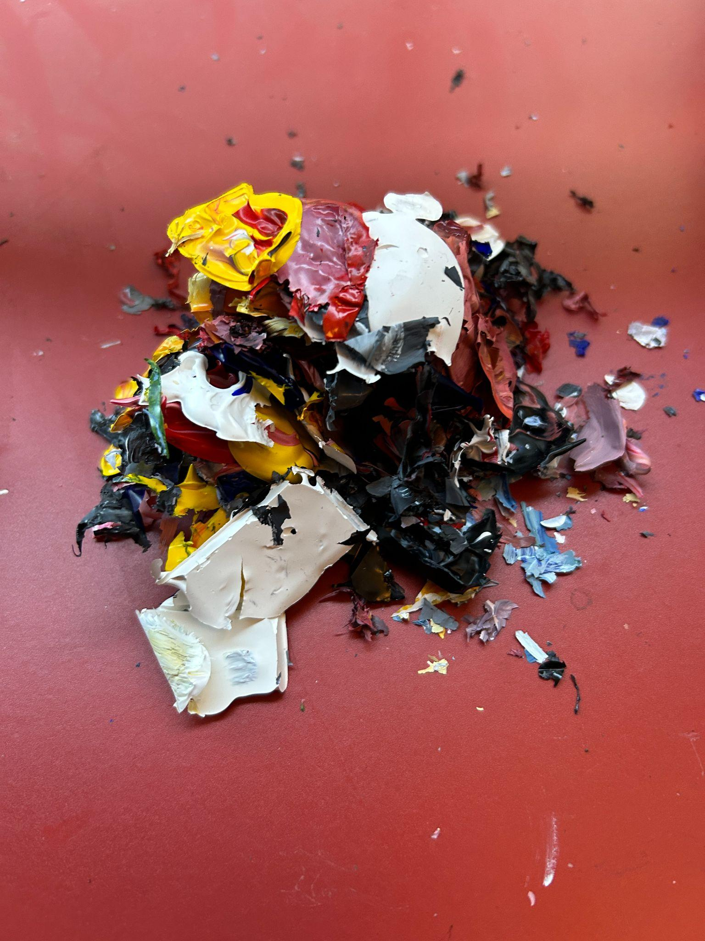
Notes:
The process:
Acrylic paint on canvas
No WIPs: uncanny valley
Setup - apartment window
Clump of dry paint
Each painting took anywhere from 2-6 hour ish sessions to complete

Slide 5

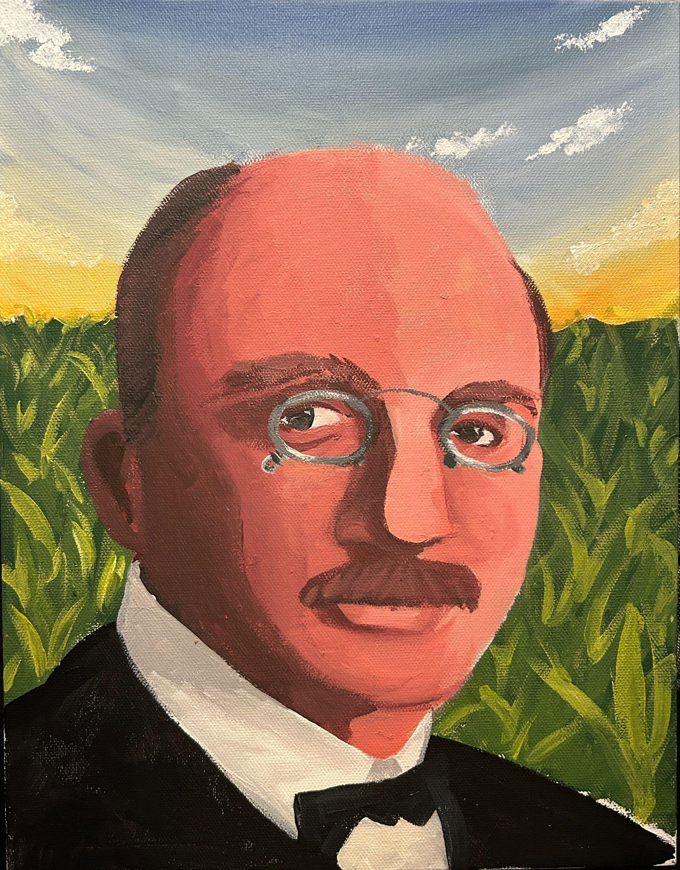
Fritz Haber

Slide 6
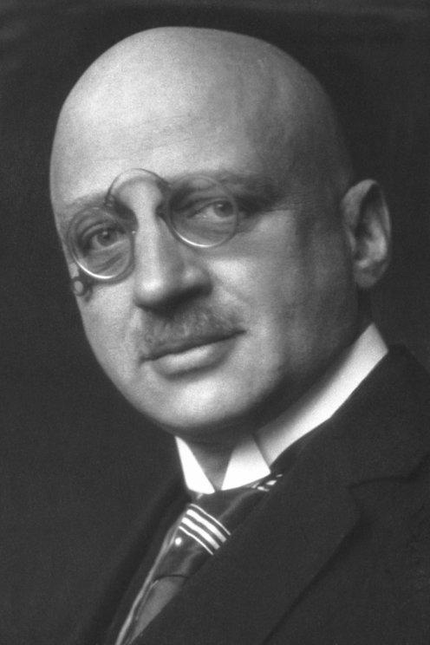
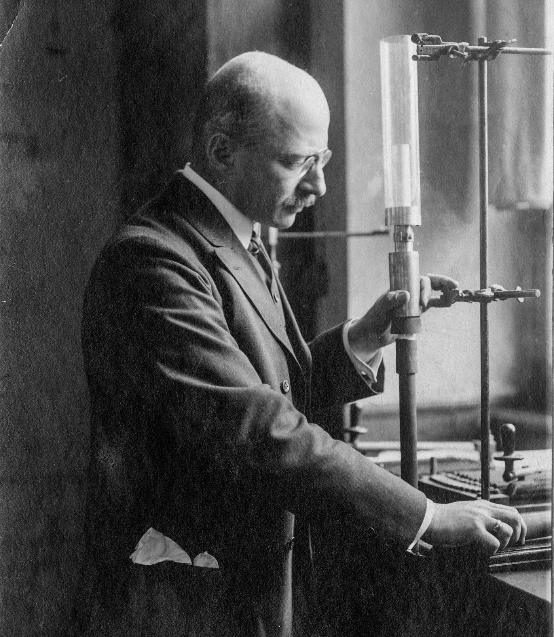
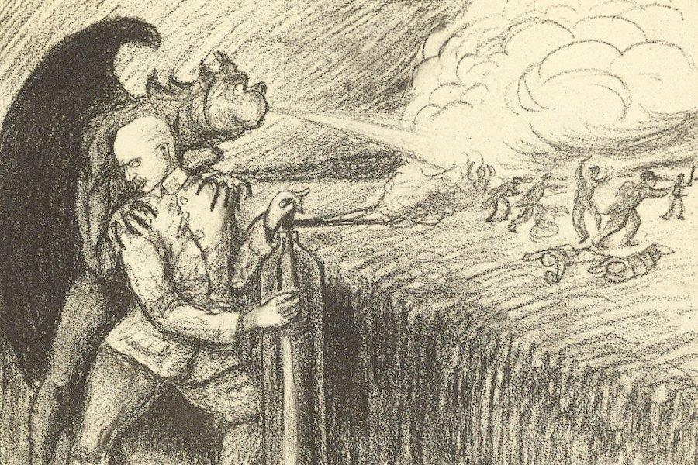
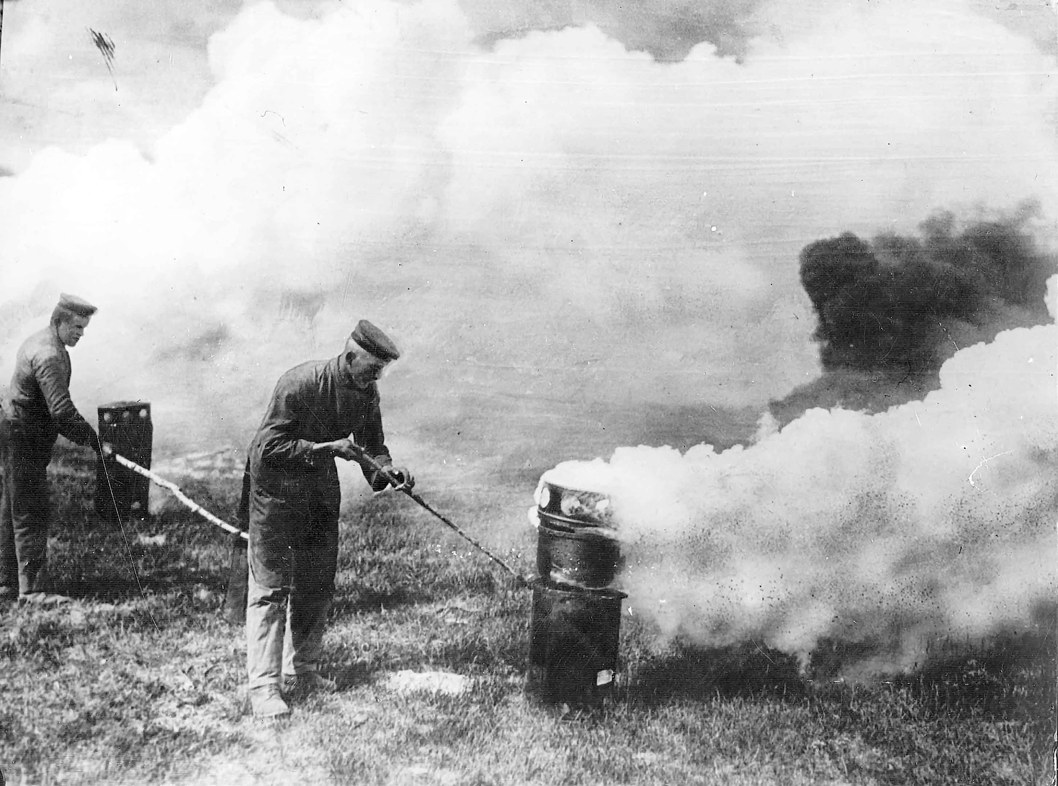
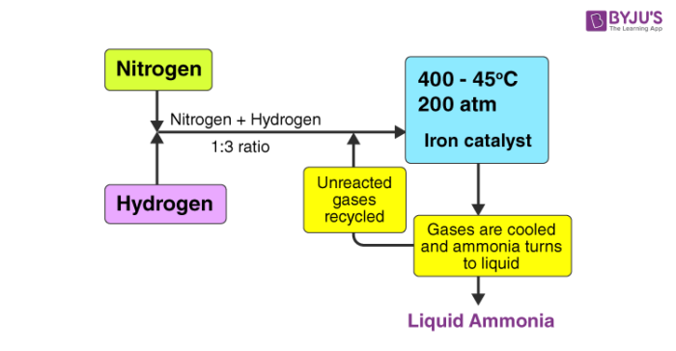
Notes:
German chemist, born in 1868
As for the background: Haber-Bosch process, makes ammonia, ⅓ of world food prod uses it, ½ of population fed by it. Also used to produce nitrates for explosives
Not the only weaponry connection: Haber invented Chlorine Gas for Germany in WW1
Disapproval from other scientists, including his wife, Clara Immerwahr, a chemist, took her life after Haber returned from overseeing first use of chlorine gas in war
Defended his invention: death is death, “during war time a scientist belongs to his country”
Use of chemical weapons is now a war crime

Slide 7
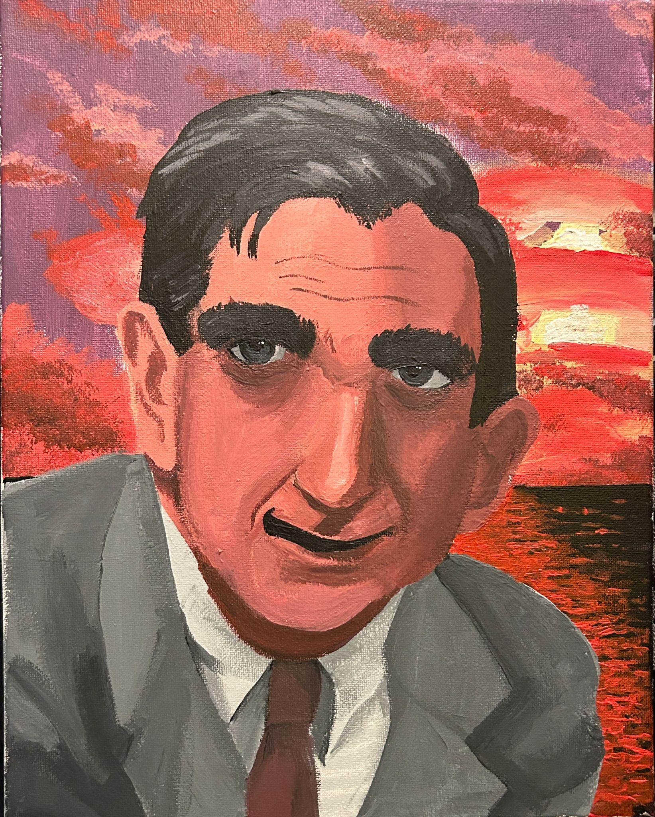
Edward Teller

Slide 8
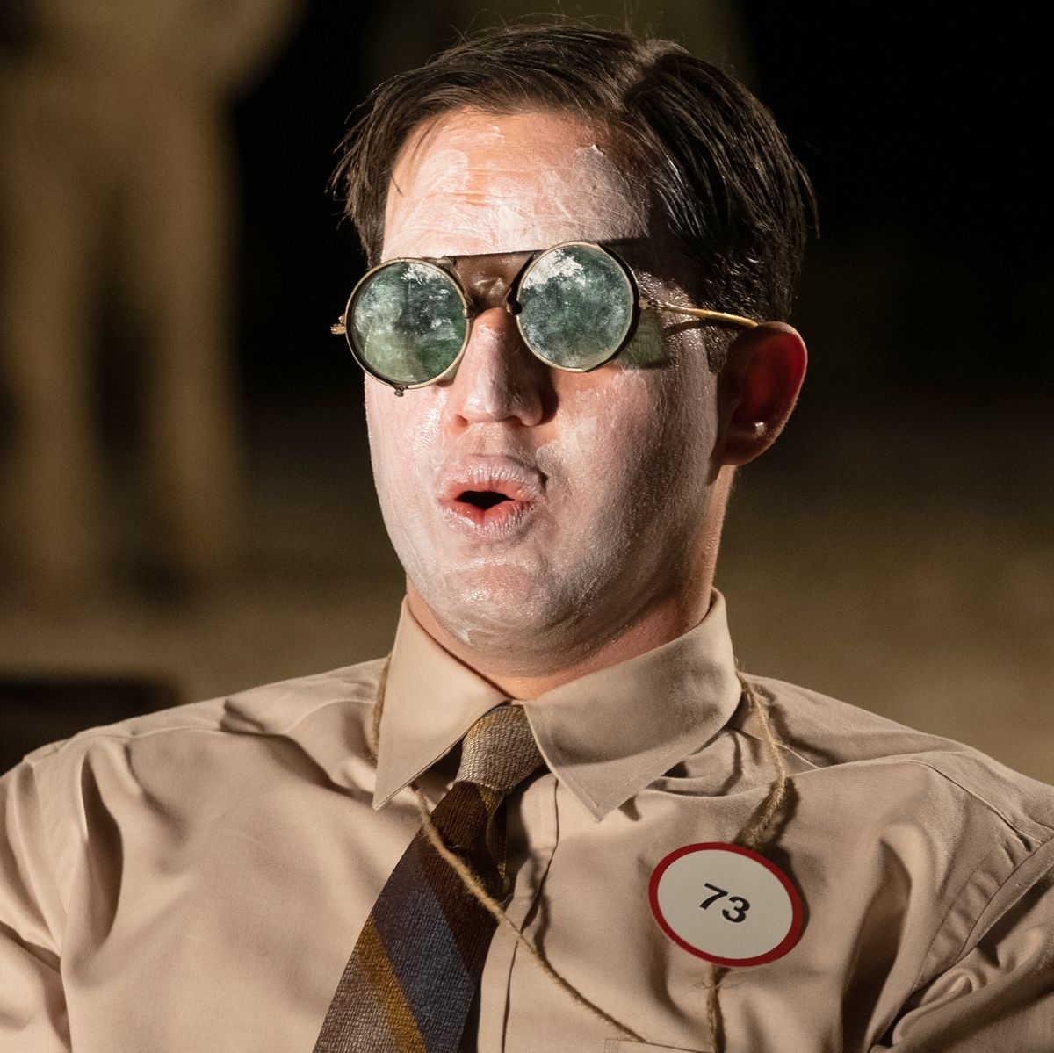
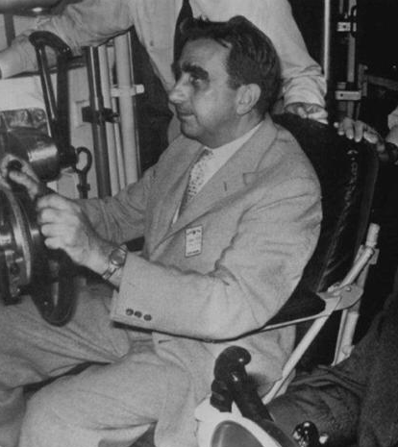
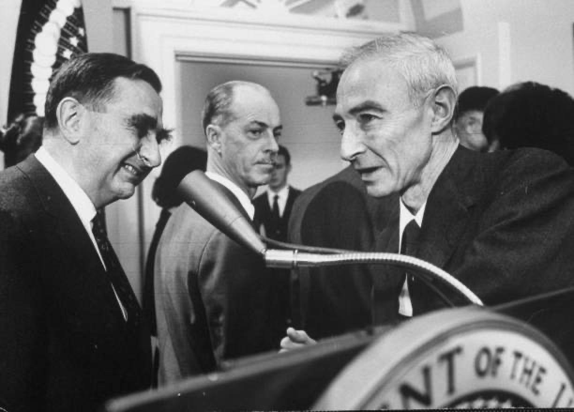
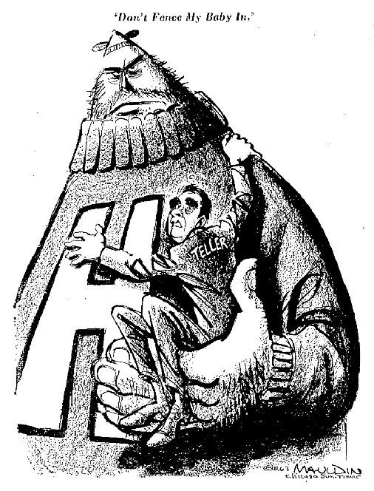
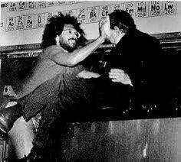
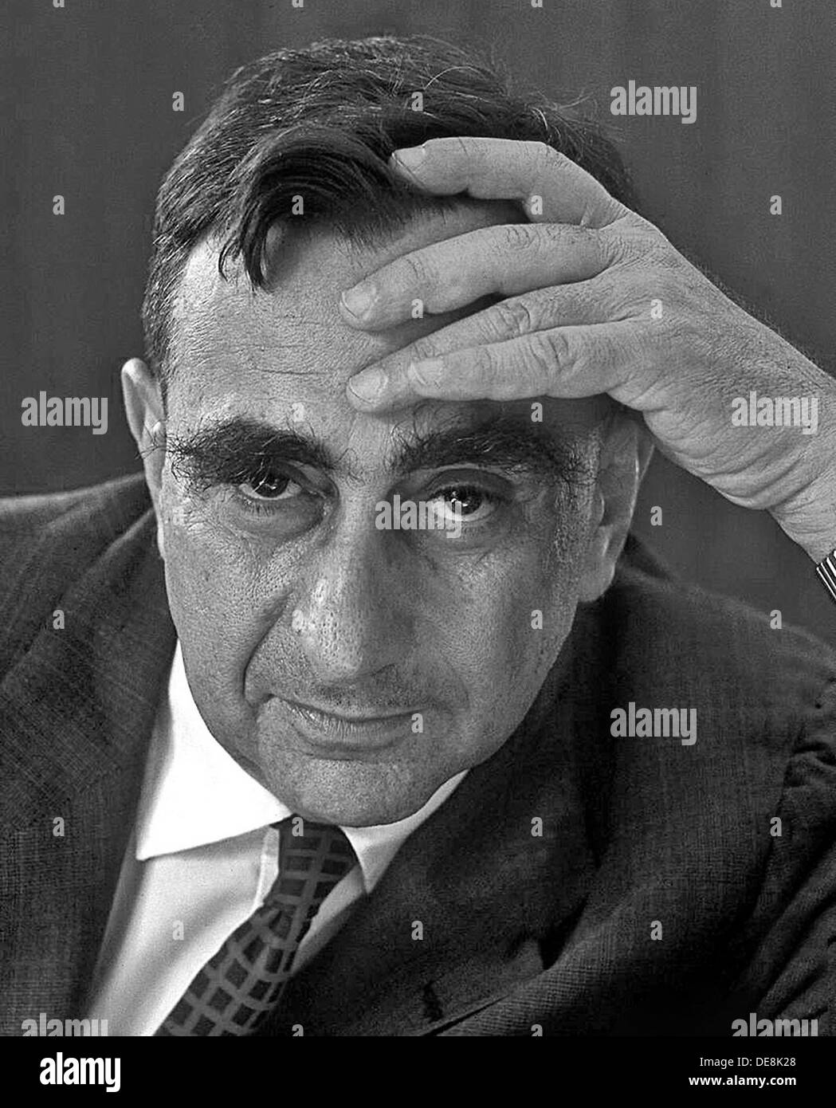
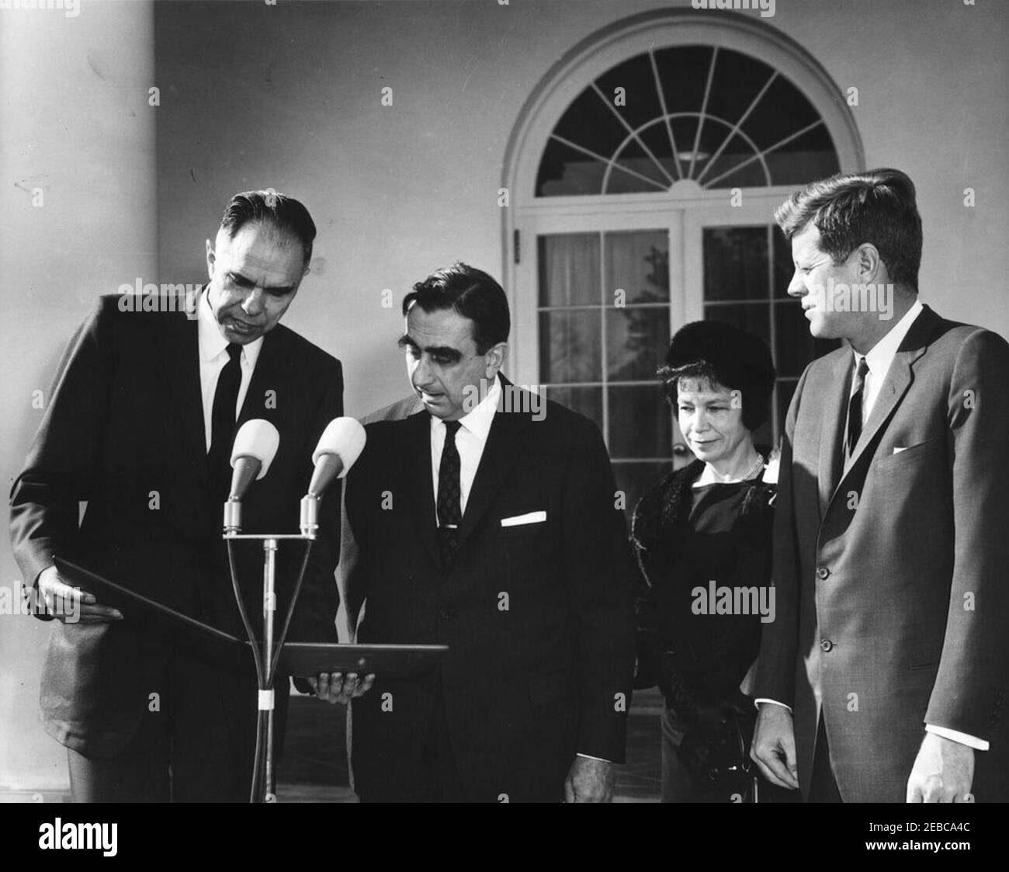
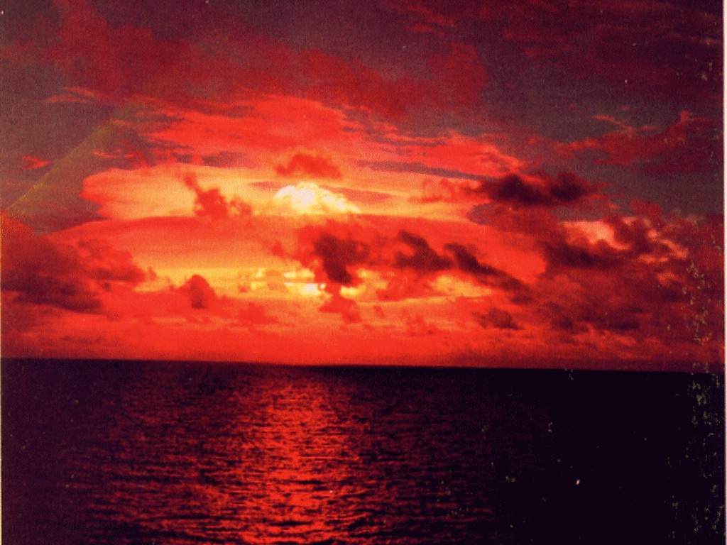
Notes:
Hungarian, later american physicist, born 1908
On the background: Beautiful sunset… just kidding! Picture of Ivy Mike, first test of the Teller-Ulam design, destroyed an island and produced 2 new elements (99 and 100)
Figure in the Manhattan project, side character in oppenheimer (yes he really did wear sunscreen and dark glasses for the first nuclear bomb test)
In fact, refused to help with nuclear bomb, because he wanted to work on the hydrogen bomb instead (first a bomb: about 25,000 tons of TNT, first h bomb: 10,000,000 tons TNT)
Like oppenheimer is called the father of the atomic bomb, teller is called the father of the hydrogen bomb; not because he solely invented it, or even came up with the idea - campaigned and insisted so persistently that it was researched and funded that he was forever associated with it
Unpopular with other scientists - not just for insistence on hydrogen bomb, but also testifying against Oppenheimer in the removal of his security clearance
Very popular with government and military - but he was always proposing ridiculous and ambitious ideas - alaskan harbor, lasers to stop missiles, bomb the moon, etc
Won the first “Ignobel peace prize” for “redefining peace as we know it”
I couldnt find the number of thermonuclear weapons the US has in its arsenal (suspicious) but largest portion of stockpile is 15 miles from here, 2000+ at Kitsap naval base
I have a clip from a silly debate show about the use of nuclear reactors for energy, Teller has a vampire esque accent

Slide 9
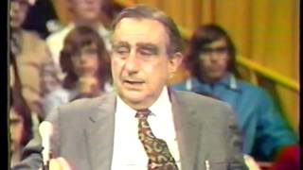

Slide 10
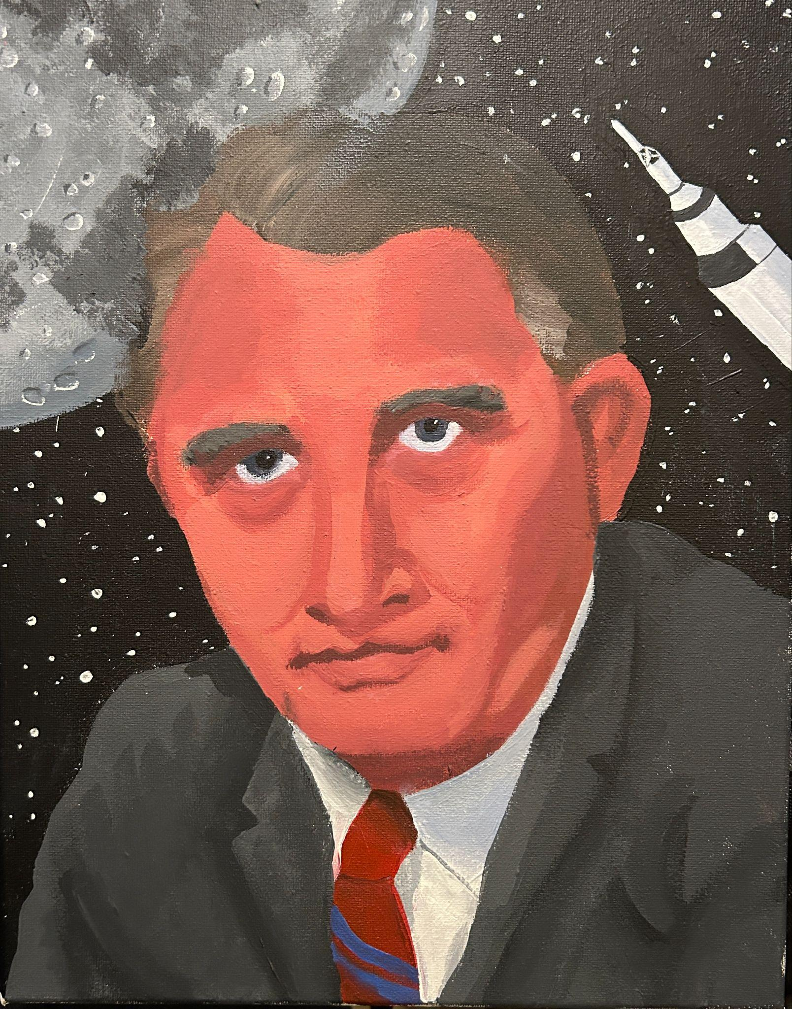
Wernher Von Braun

Slide 11
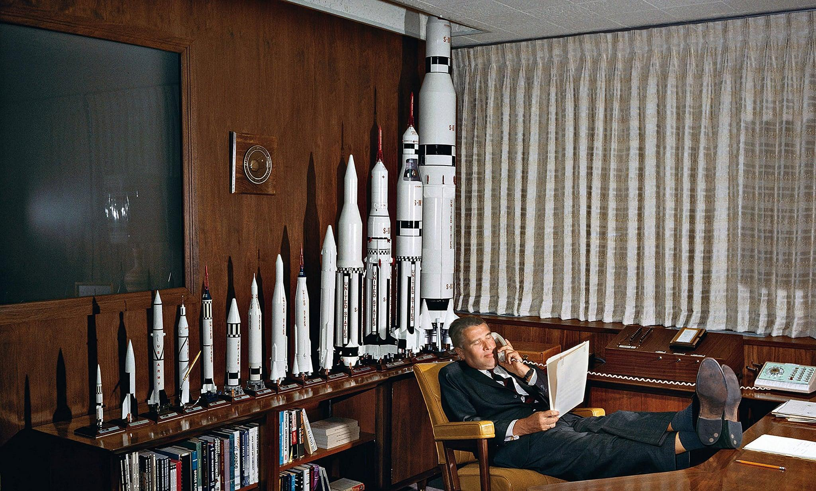
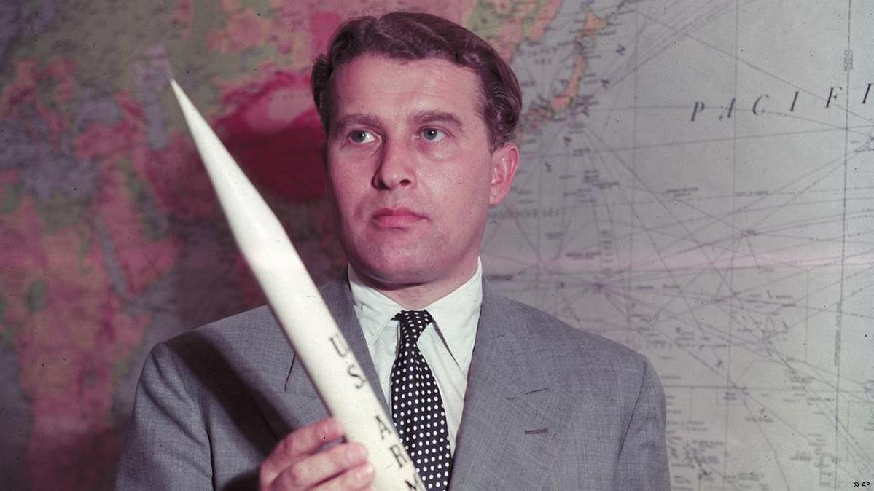
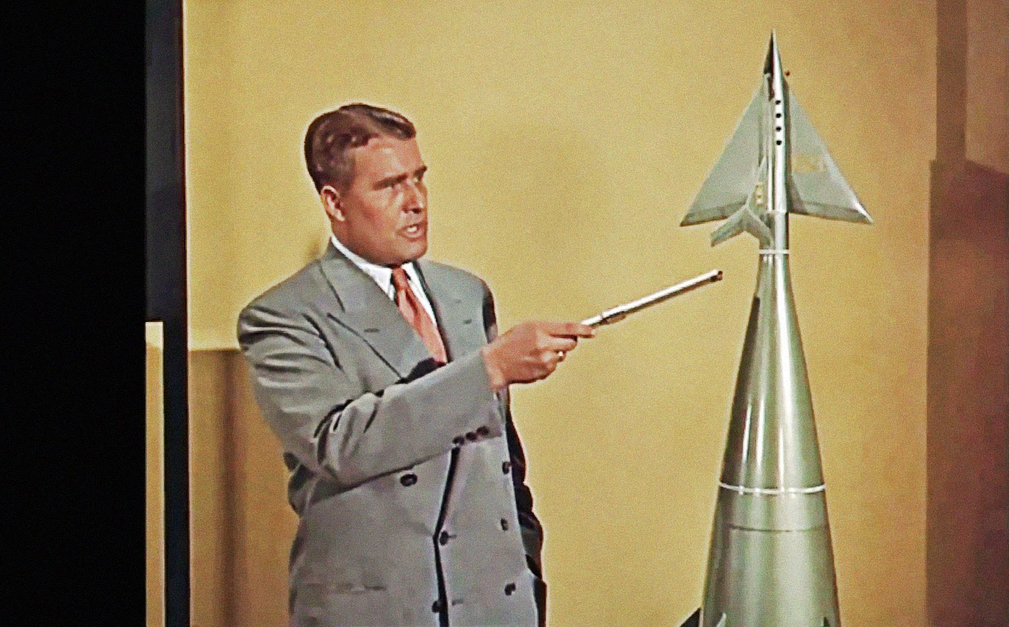
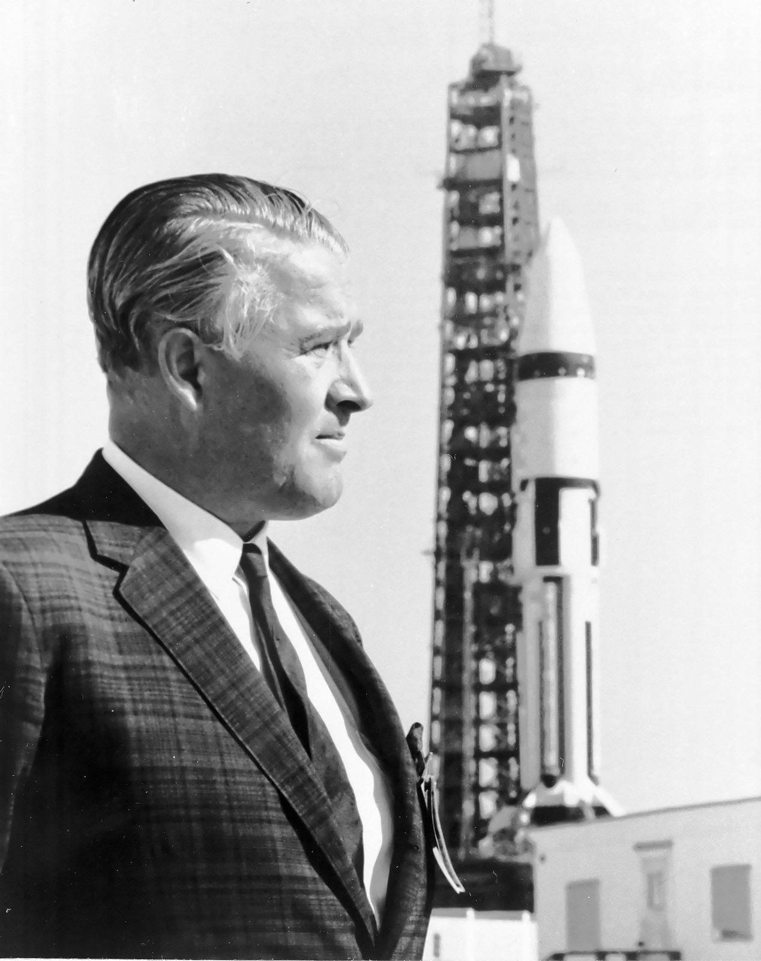
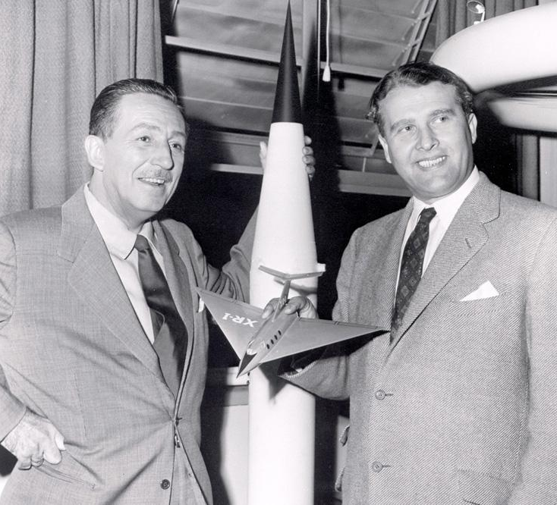
Notes:
German engineer, born 1912
On the background: Von Braun directed the design of the Saturn V rocket, which launched Apollo 11 to the moon
Not the only rocket he designed… he also designed the V-2 rocket, worlds first long range guided ballistic missile, for Nazi Germany in WWII
Mascot for Operation Paperclip, secret US operation to employ former Nazi scientists
Described as a “controversial figure” and having a “complicated and ambivalent” relationship with Nazism. FBI concluded he was advancing his career, and scared of consequences
Was a member of the party, Major in the SS, and obviously worked on an important weapon in Nazi Germany’s arsenal
Public facing in the US, went on multiple Disney specials and headed NASA programs, hushed about his past
quote i like - “I aim for the stars, but sometimes I hit London”
Another clip, from NASA in the 60s, Von Braun informational video on equal opportunity employment (shown to employees during training)

Slide 12
